Slide 1


Armenian Genocide
Student Support & Attendance Services
Human Relations, Diversity & Equity

Slide 2
Welcome/ check in - Would You Rather...
Be the song writer
Be the singer

Slide 3
Objectives
Learn what the Armenian Genocide is
1
Discuss why it's important to recognize it
2
Learn about additional resources for more information
3

Slide 4
What is genocide?
the deliberate killing of a large group of people, especially those of a particular ethnic group or nation.

Slide 5
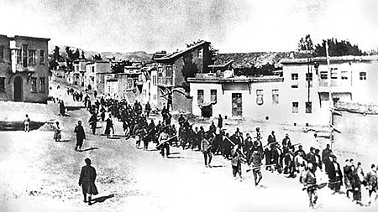
WHat is the Armenian genocide?
The systematic murder and expulsion of 1.5 million ethnic Armenians carried out in Turkey and adjoining regions by the Ottoman government between 1914 and 1923.
On 24 April 1915, the Ottoman authorities arrested about 250 Armenian leaders and deported them to Angora (Ankara). Most were eventually murdered.

Slide 6
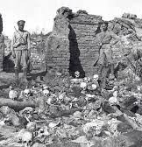
What is the armenian genocide?
The Armenian Genocide was carried out during and after WWI and implemented in two phases—the killing of men through massacre and subjection of army conscripts to forced labor followed by the deportation of women, children, the elderly, and the infirm on death marches leading to the Syrian Desert.

Slide 7
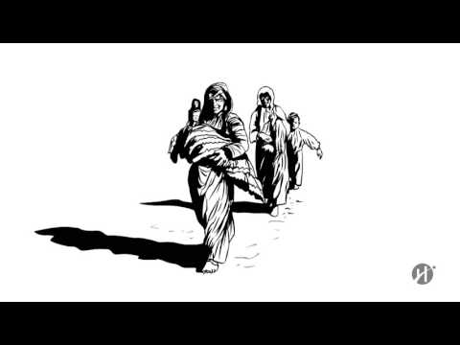
The Armenian genocide
1915

Slide 8
Armenian genocide remembrance
1975
In 1975, The US House of Representatives recognized April 24 as a National Day of Remembrance of Man's Inhumanity to Man in recognition of the Armenian Genocide.
1977
In 1977, California State Assembly declared 24 April as a Day of Remembrance for the Armenian Genocide
24 Apr.
Armenian Genocide Remembrance Day occurs on April 24. Beginning in 2021/22 schools will be closed on that day.

Slide 9
The controversy
The Turkish government denies that this was a genocide. They refer to this period as an international war and an intercommunal struggle, during which as many, if not more, Muslims and Jews died as did Armenians.
Why is it important to Armenians that Turkey acknowledges that it was a ‘genocide?’
Why would Turkey resist it being called a genocide?
Could this be resolved?
Notes:
https://www.mfa.gov.tr/the-armenian-allegation-of-genocide-the-issue-and-the-facts.en.mfa

Slide 10
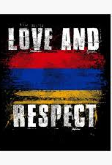
THe importance
Learning about our individual cultures and the history of our people is extremely important to our identities.
Learning about other cultures and their history creates acceptance for those cultures
Learning about the histories of injustice encourages social change and justice

Slide 11
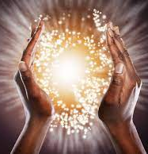
The call for healing using the past to inform our future
While it is important to remember what occurred and to learn about this history, there is also a need to heal from this trauma.
We are not responsible for the behaviors of our ancestors and should not hold people today accountable for the transgressions of their ancestors.
We can honor our ancestors by promoting peace and reconciliation!
Harassment and bullying, are not only destructive, but will require action to be taken by the school.

Slide 12
Let's Talk
Why do you think healing from traumatic historical events is important?
Why do you think it's important to acknowledge important events in history?

Slide 13
For more resources about the armenian genocide:
Armenian Embassy & Consulate Information https://www.consulate-info.com/consulate/2383/Armenia-in-Los-Angeles
Armenian Genocide – History Channel https://www.history.com/topics/world-war-i/armenian-genocide
The Armenian Genocide – 8 lessons by Facing History & Ourselves https://www.facinghistory.org/topics/genocide-mass-violence/armenian-genocide

Slide 14
Check out
What is one important thing you learned about the Armenian Genocide?
How can this generation promote peace?

Slide 15

Your feedback is important to us

Slide 16
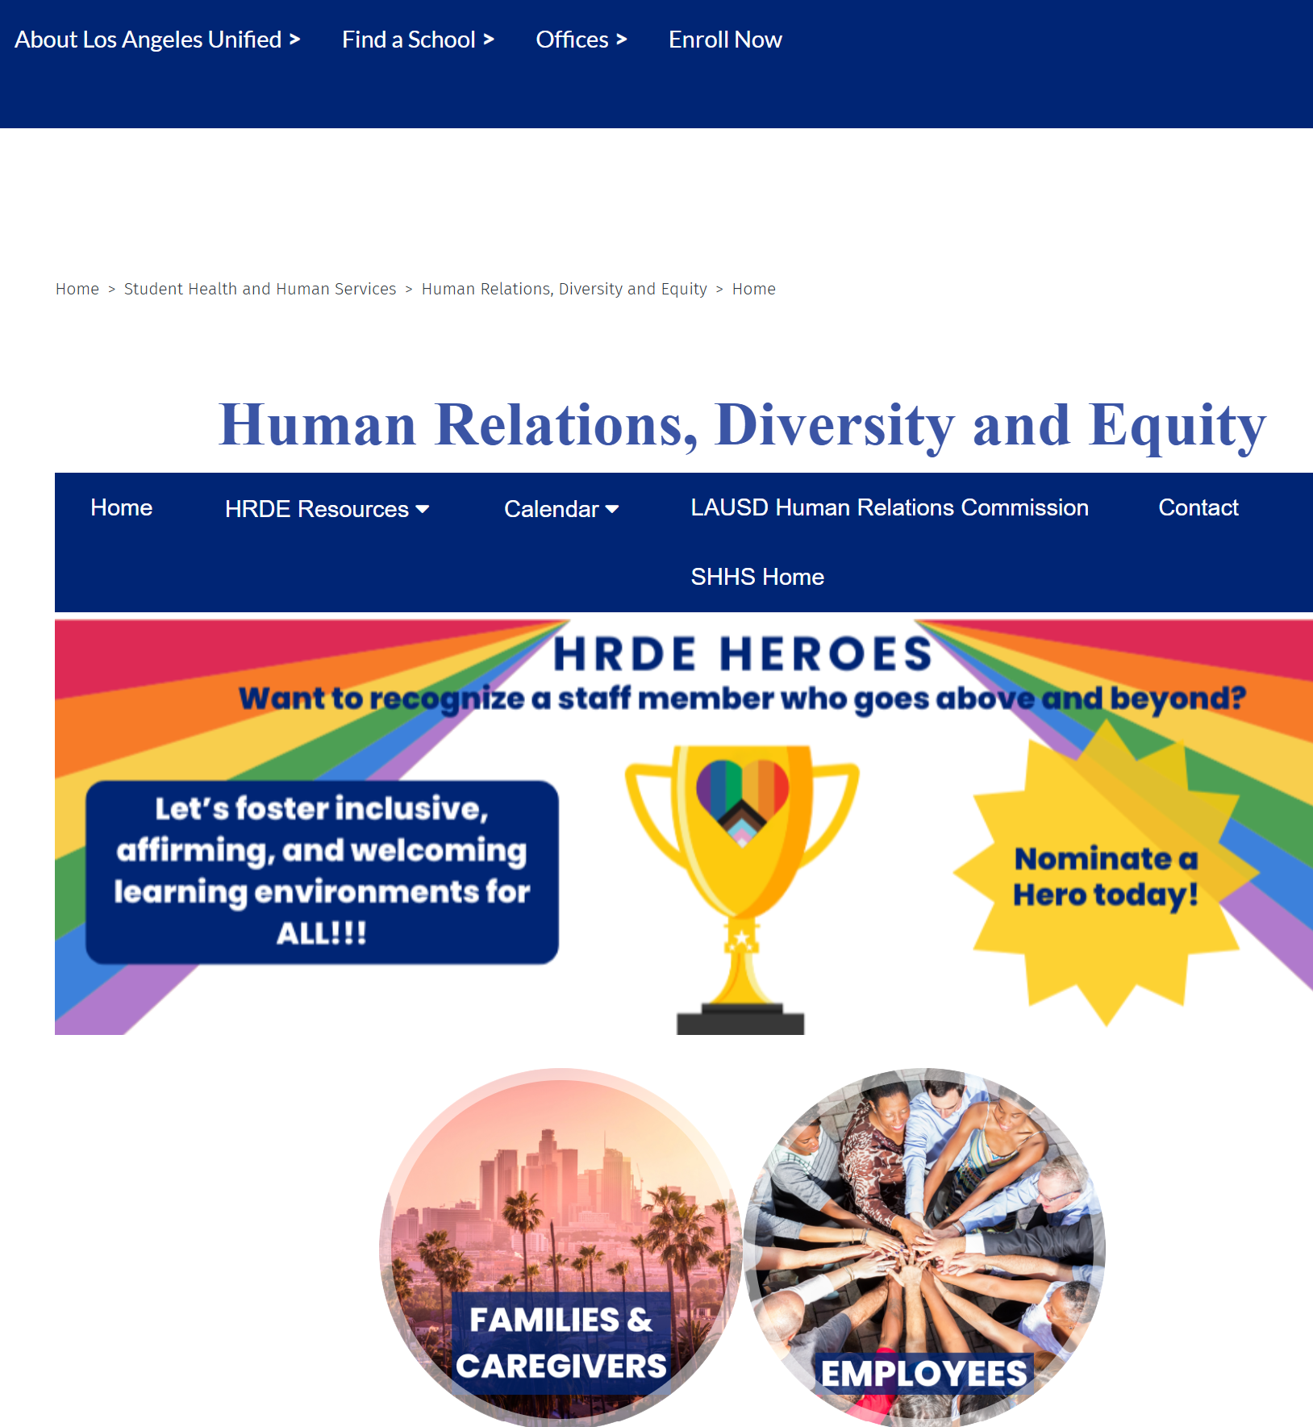
For additional resources, visit us at: https://www.lausd.org/human-relations

